Slide 1
My dream job
And how to get it
1113 황준화
Notes:
Hello, my name is 황준화 I come here to introduce my dream job dan way how to get it.

Slide 2



What is my future job?
Chemist
Chemist
Scientist
Physicist
Physicist
Biologist
Biologist
Notes:
My dream job is scientist like chemist, physicist biologist.

Slide 3
What is my future job?
Clear
Has no variable
Notes:
Because Science is very clear and has no variable. I like this so but we can’t to be scientist without effort.

Slide 4




What are some obstacles I will face on my path to this job?
1. Study
2. CSAT
Math
University
Math
University
Science
College
Science
Notes:
To be scientist, we need to study. Science and Math is important. And, good CSAT(College Scholastic Ability Test) score to make to go university and college easily.

Slide 5
What do I need to do get this job?
Education: The more, the better
Certificates: The more, the better
Skills: The more, the better
Other things: The more, the better

Slide 6
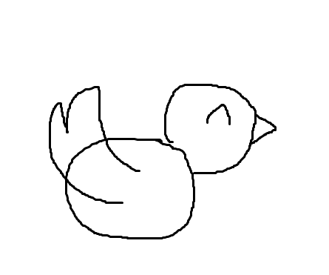
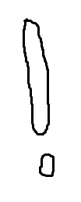
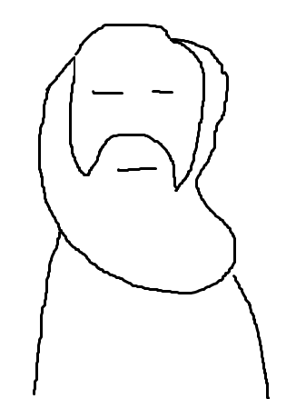


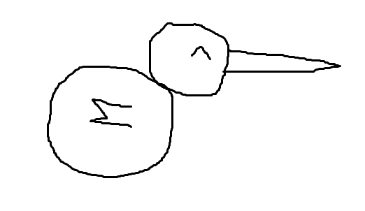
My role model
Charles Darwin
evolution
Notes:
My role model is Charles Darwin. He detect evolution with many bird. Other people say it is wrong but he didn’t give up. I like his this point so he is my role model.

Slide 7
Thank you
For watching my PPT
1113 황준화

